Slide 1


DEPARTMENT OF COMPUTER SCIENCE & ENGINEERING
Subject Name: Multimedia Technologies
Subject Code: (20CST-334/20ITT-334)
Lecture 14
Topics Covered: Colour Science, Colour Models
DISCOVER . LEARN . EMPOWER

Slide 2
Color science
Color science encompasses many technologies, one of which is multimedia. Looking at the breadth of activities and industries that define color science can provide insight into current and future problems for multimedia imaging and their solutions.

Slide 3
Color science
Multimedia imaging requires the fundamental knowledge that constitutes such disciplines as mathematics, physics, chemistry, physiology, and psychology. We further require applied knowledge that constitutes disciplines including computer science, information processing, imaging science, and color science. This view of multimedia imaging places color science in a subordinate position. However, it can be worthwhile to exchange the positions. That is, multimedia imaging is but one of many technologies that exemplify color science. This approach has been described previously by the author regarding educational imperatives
(1) and as a pedantic vehicle for describing the relationships between user controls and resulting color for various color technologies
(2). This approach will be revisited within the context of multimedia imaging

Slide 4
Color science
Human Vision
The eye works like a camera, with the lens focusing an image onto the retina (upside - down and left - right reversed). The retina consists of an array of rods and three kinds of cones, so named because of their shape. The rods come into play when light levels are low and produce an image in shades of gray ("At night, all cats are gray!"). For higher light levels, the cones each produce a signal. Because of their differing pigments, the three kinds of cones are most sensitive to red (R), green (G), and blue {B) light.

Slide 5
Color science
Spectral Sensitivity of the Eye
The eye is most sensitive to light in the middle of the visible spectrum. Like the SPD profile of a light source for receptors we show the relative sensitivity as a function of wavelength. The blue receptor sensitivity is not shown to scale, because it is much smaller than the curves for red or green. Blue is a late addition in evolution (and, statistically, is the favorite color of humans, regardless of nationality — perhaps for this reason: blue is a bit surprising!). The following figure shows the overall sensitivity as a dashed line, called the luminous - efficiency function. It is usually denoted V(X) and is the sum of the response curves to red, green, and blue.

Slide 6
Color science
Light and Spectra
Recall from high school that light is an electromagnetic wave and that its color is characterized by the wavelength of the wave. Laser light consists of a single wavelength — for example, a ruby laser produces a bright, scarlet beam. So if we were to plot the light intensity versus wavelength, we would see a spike at the appropriate red wavelength and no other contribution to the light.

Slide 7
COLOR MODELS IN IMAGES - MULTIMEDIA
We now have had an introduction to color science and some of the problems that crop up with respect to color for image displays. But how are color models and coordinates systems really used for stored, displayed, and printed images?
RGB Color Model for CRT Displays
We usually store color information directly in RGB form. However, we note from the previous section that such a coordinate system is in fact device - dependent.
We expect to be able to use 8 bits per color channel for color that is accurate enough. In fact, we have to use about 12 bits per channel to avoid an aliasing effect in dark image areas — contour bands that result from gamma correction, since gamma correction results in many fewer available integer levels.
For images produced from computer graphics, we store integers proportional to intensity in the frame buffer. Then we should have a gamma correction LUT between the frame buffer and the CRT. If gamma correction is applied to floats before quantizing to integers, before storage in the frame buffer, then we can use only 8 bits per channel and still avoid contouring artifacts.

Slide 8
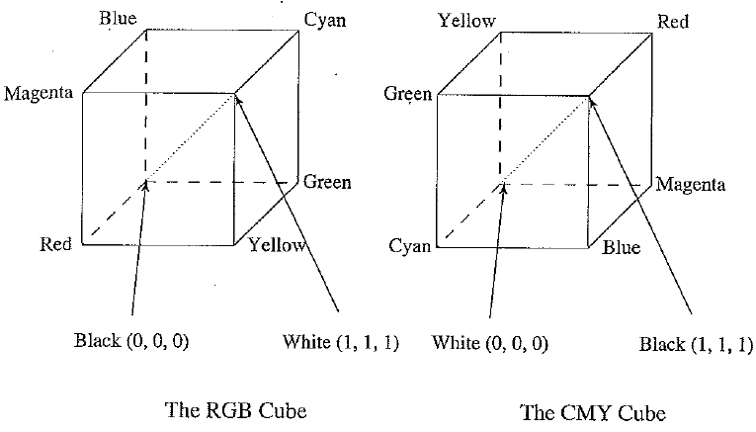
RGB and CMY color cubes. (This figure also appears in the color insert section.)

Slide 9
COLOR MODELS IN IMAGES - MULTIMEDIA
Subtractive Color: CMY Color Model
So far, we have effectively been dealing only with additive color. Namely, when two light beams impinge on a target, their colors add; when two phosphors on a CRT screen are turned on, their colors add. So, for example, red phosphor + green phosphor makes yellow light.
But for ink deposited on paper, in essence the opposite situation holds: yellow ink subtracts blue from white illumination but reflects red and green; which is why it appears yellow!
So, instead of red, green, and blue primaries, we need primaries that amount to — red, — green, and — blue; we need to subtract R, G, or B. These subtractive color primaries are cyan (C), magenta (M), and yellow (Y) inks. The above figure shows how the two systems, RGB and CMY, are connected. In the additive (RGB) system, black is "no light", RGB — (0, 0, 0). In the subtractive CMY system, black arises from ^subtracting all the light by laying down inks with C = M = Y = 1.

Slide 10

COLOR MODELS IN IMAGES - MULTIMEDIA
Transformation from RGB to CMY
Given our identification of the role of inks in subtractive systems, the simplest model we can invent to specify what ink density to lay down on paper, to make a certain desired RGB color, is as follows:
Additive and subtractive color: (a) RGB is used to specify additive color; (b) CMY is ased to specify subtractive color. (This figure also appears in the color insert section.)

Slide 11
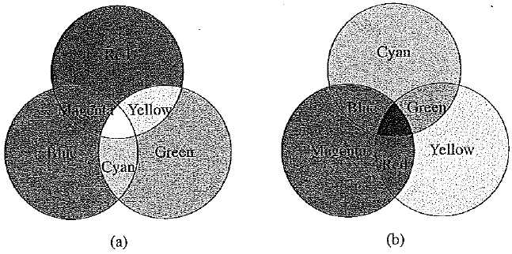
COLOR MODELS IN IMAGES - MULTIMEDIA

Slide 12
Reference and text books:-
TEXT BOOKS
Tay Vaughan, “Multimedia making it work”, Tata McGraw-Hill, 2008.
Rajneesh Aggarwal & B. B Tiwari, “Multimedia Systems”, Excel Publication, New Delhi, 2007.
Li & Drew, “Fundamentals of Multimedia”, Pearson Education, 2009.
REFERENCE BOOKS
Parekh Ranjan, “Principles of Multimedia”, Tata McGraw-Hill, 2007
Anirban Mukhopadhyay and Arup Chattopadhyay, “Introduction to Computer Graphics and Multimedia”, Second Edition, Vikas Publishing House.

Slide 13
Any query ??

Slide 14
Thank you

